Slide 1
Assignment notes
Reece Davies

Slide 2
What I’ve done
Tested the code, adding in a new agent named “agent3”.
Changed the ‘solidBrush; to ‘Color.Black’ to better simulate ants.
Created an ‘antList’ to generate multiple ants.
Created a Random for both X and Y position so the ants don’t all start in the same position. Changed it so they are scattered.
Decreased the size of the agents.
Changed the code, so if they are within some distance of ‘someObject’, they will approach the food ‘someObject’.
If they get to ‘someObject’, they change colour to red.
Using pen and paper, created Booleans for each situation.
Using pen and paper, created scenarios for IF statements in certain situations.
Changed the colour of the ants depending on each situation. Red = has food. Blue = knows nest location. Black = neither.
Changed the IF statement structure to fix the logic errors that were occurring, and it fixed the problem.
Added methods to pick up food, and put down food.
Removed ‘Wander();’ so the ants would go directly between the food and nest.
Changed ‘someObject’ to ‘foodObject’ to make it more relevant to the program.
Changed some code that was used in early testing. So if the ants pick up food, they do not immediately know where the nest location is.
Created a nested loop that will check whether each ant is in close proximity of each other. Containing multiple IF statements.
Created a method that will transfer information between ants.
Called the method in the nested loop.
Changed the nest and food graphics to ellipses, as opposed to rectangles.
Created a Food class
Created a constructor for the food class, containing SOFT152Vector for the mouse position.
Changes the code so if the user clicks, it adds a new item to a list.
Drafted on paper, plans for behaviours with food list.
Created a nested loop in ‘DrawAgentsDoubleBuffering’ method, so the program will draw all food that user puts down.
Adjusted behaviours, depending on the situation, to work with a food list, as opposed to one vector (Scenario 2)
Created ‘SpecificFood’ variable so the ants goes to a specific food.
Implemented ‘SpecificFood’ into scenarious, so ants will approach one food vector.
Created Nest class.
Created Nest List.
Made it that when user clicks, new item for nest is added to ‘nestList’.
Remove the ‘IsCloseToAnt’ property, as I did not end up needing it.
Added ‘SpecificNest’ for when I will need it.
Made a new loop in ‘DrawAgentsDoubleBuffering’ that would draw all nest objects within the list.
Adjusted behaviours, depending on the situation, to work with nest list, as opposed to one vector (Scenario 3).
Created new variable ‘closeProximityTo’ to be used for the IF statements for when an ant is close to food, or nest. Better than using integers, as will be easier to change in the future when the ants become smaller.
Adjusted when the ants communicate. There was a logic error in which the if stateents would only consider the X position when using the method ‘AskForDirections()’.
Created ‘RobberAnt’ class.
Created ‘RobberNest’ class.
Put code in ‘RobberNest’ to be the same as ‘Nest’.
Created an if statement in ‘PickUpFood’ so if the item is larger than 0.3, the ants would pick up the food. If not however, the item will be deleted from the list.
Created new if statement in ‘foodList’ loop to check if the value is null. If it is not, then the program will read it.
Commented out some code that removes item from ‘foodList’, and instead tried to make it so the ants would not consider food that is smaller than a specific size.
Added back the ‘RemoveAt’, but the NullReferenceException still occurs.

Slide 3
What I’ve done
Created new method ‘DestroyFood’.
Created if statement to check if the food is larger than or smaller than 0.3. It will either ‘PickUpFood’ or ‘DestroyFood’.
Created a loop in ‘DestroyFood’ so if the specific food variable is equal to foodID, the ants will forget the food location. Didn’t work properly. Still getting the exception
Duplicated ‘AntAgent’ and changed name and constructors to ‘RobberAnt’. Will change attributes and variables in due time.
Added (!= null) if statements to prevent exceptions.
Added if else (then wander) for if it was null, to prevent the ants losing the will to live.
Changed food size difference to 0.1 when ‘PickUpFood’ was called.
Copied all necessary code for ant agents and changed it to relate to the robber ants. Although I created a nested loop, so the robber ants are moving 5 times faster than the normal ants.
Created new buttons, and purpose of each button.
Changed layout of user interface.
Deleted ‘start’ button.
Created (kinda) the robber ant scenarios.
Allows the robber ants to steal.
Worked on theft.
Adjusted steal food condition so the robber ant must not be already carrying food.
Created new point and vector. Set this to antList Position. ‘foodPositionVector’.
Made robber ants approach this ‘foodPositionVector’.
Created a counter so the ants would forget food after counter reaches its limit.
Changed ant shape from rectangle to ellipse.
Made it that ‘SpecificFood’ will increase when ‘DestroyFood()’ is called.
Duplicated the project, and now attempting to make it that the robber ant and robber nest inherit their information from the ant agent class, and nest class.
Changed if statement condition for distance between ants to contain “Math.Pow” and “Math.Sqrt”.

Slide 4
Things still left to do
Get positioning right with food and nest (collecting).
Implement closest nest/food variable so the ants go to the closest one.
Allow the robber ants to steal.
Create robber ant scenarios.
Make robber ants remember food location.
Fix memory problem.

Slide 5
Things I can add to the report
(Student ID: 10572794)
Conclude with an Evaluation.
Why I have used List<T>.
Add UML class diagram.
Rearrange algorithm design.
Add Pseudo code.
Add behaviour algorithm.
Change diagram images.
Finalise Evaluation.
Remove certain Methods.

Slide 6
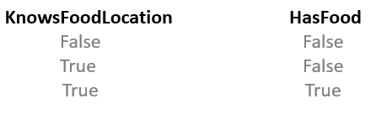
KnowsFoodLocation HasFood
False False
True False
True True

Slide 7
Report structure plan #1
Chapter 1
Introduction
Background information (objectives)
Method of approach (initial design)
Chapter 2
Classes used
Each class explained
Lists used
Chapter 3
Problems encountered
Evaluation
Improvements to be made
Any enhancements or features included which were NOT in the original

Slide 8
Report structure plan #2
Introduction
Background information (objectives)
Method of approach (initial design)
Classes used
Each class explained
Algorithm design
Evaluation
Evaluation
How successful I feel about the program.
The logic error that occurs.
What I can do to improve the program (why the food location is stored in food class, and same for nest, as opposed to the ant remembering it)(make ants inherit from parent class + why it hasn’t been done).

Slide 9
Sources
Collective intelligence
https://www.edge.org/conversation/thomas_w__malone-collective-intelligence

Slide 10
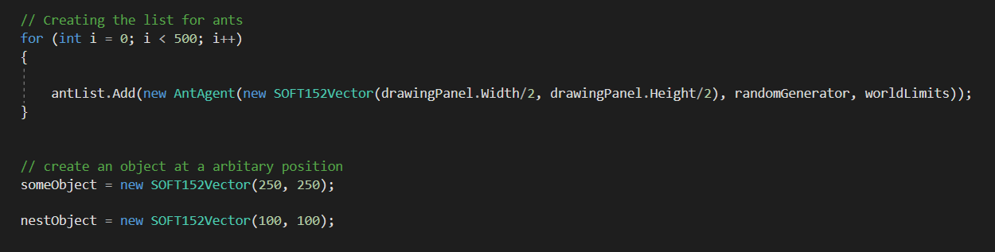
Adding an ant List
Code I used to create the list for the ants, spawning them in the centre of the panel using ‘drawingPanel.Width’ and ‘drawingPanel.Height’.

Slide 11
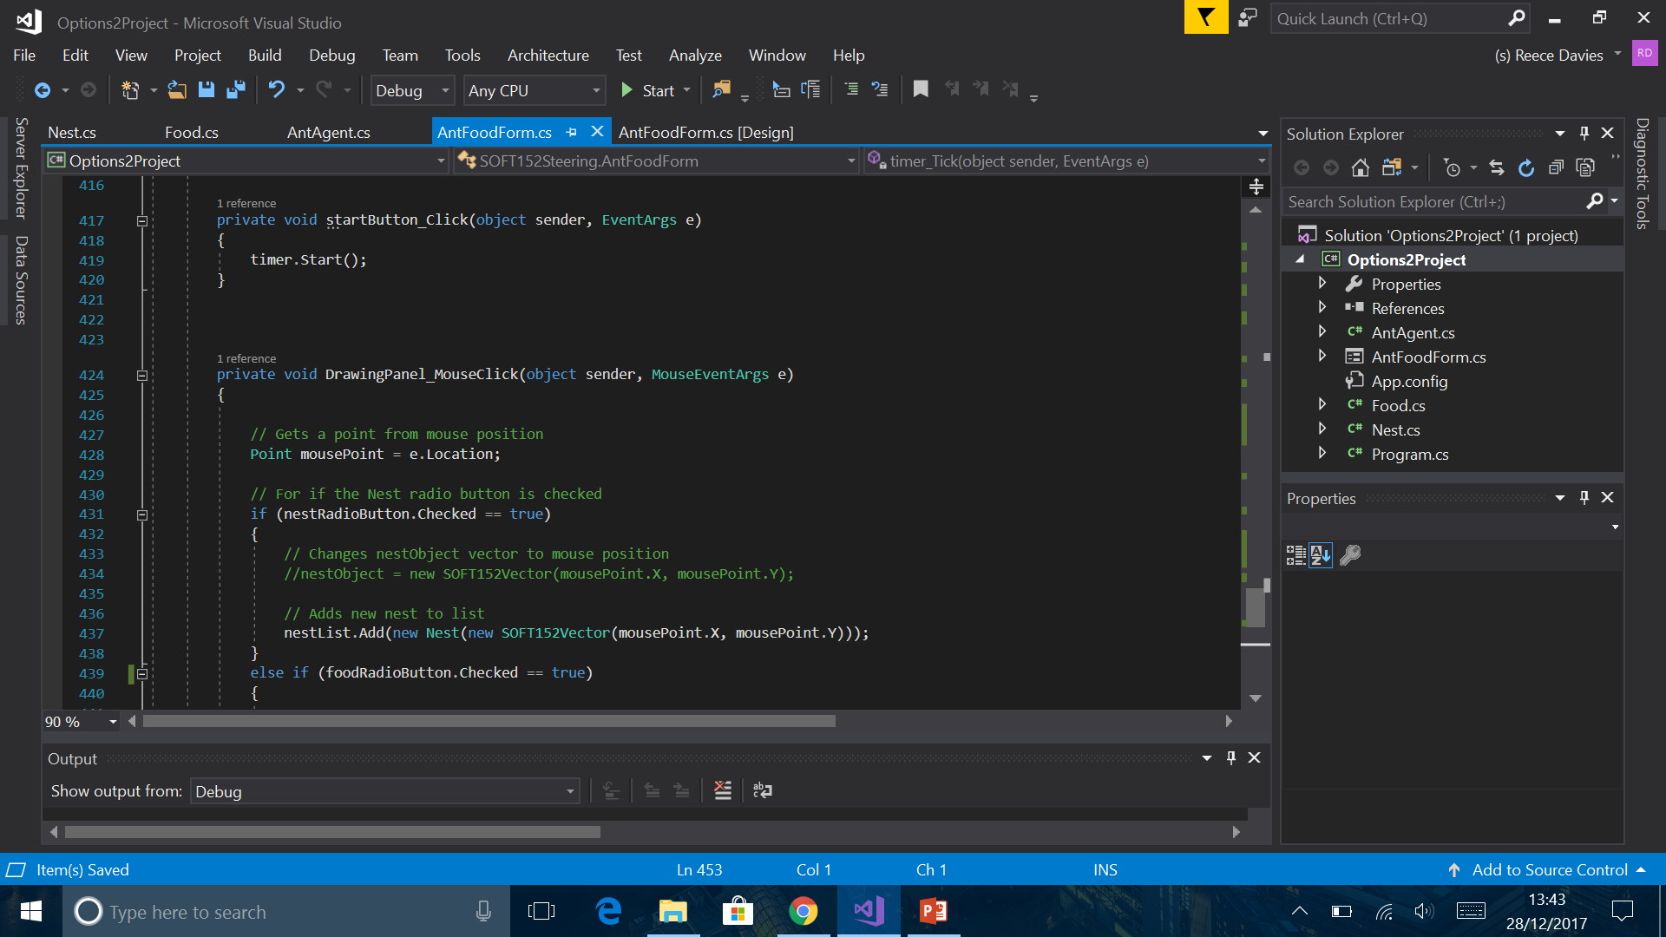
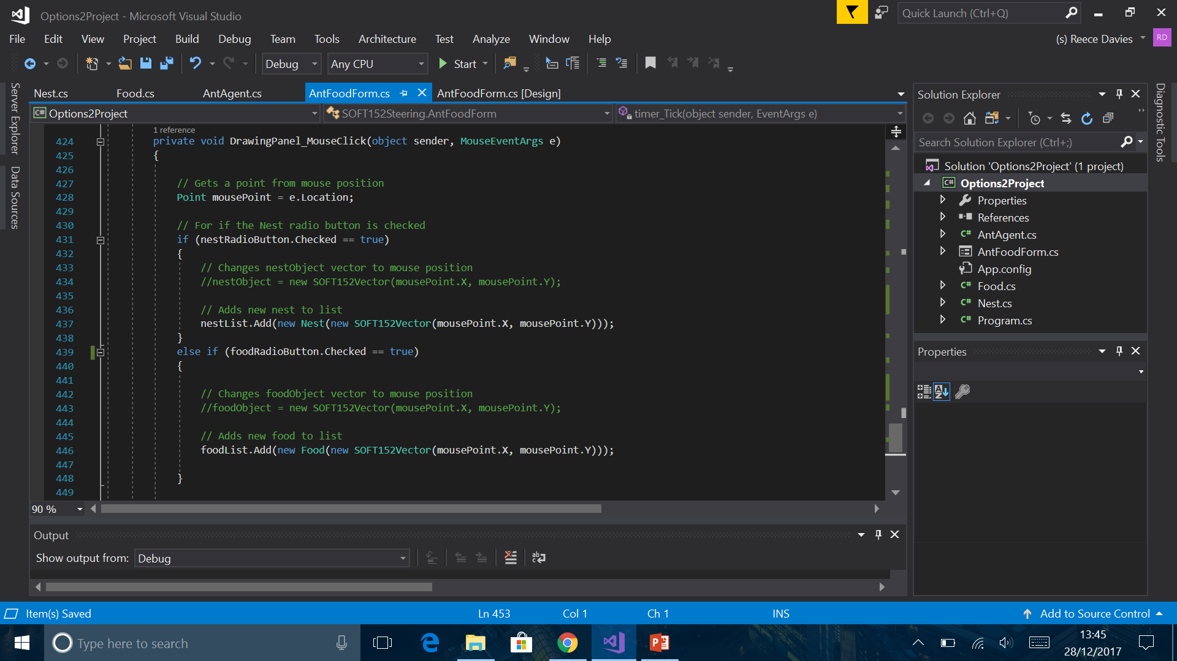
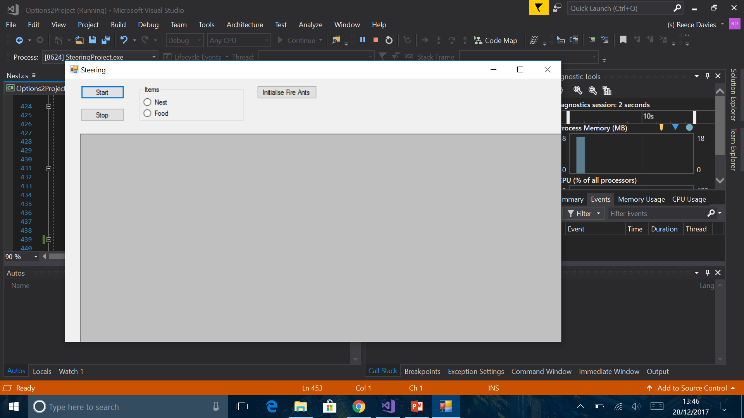
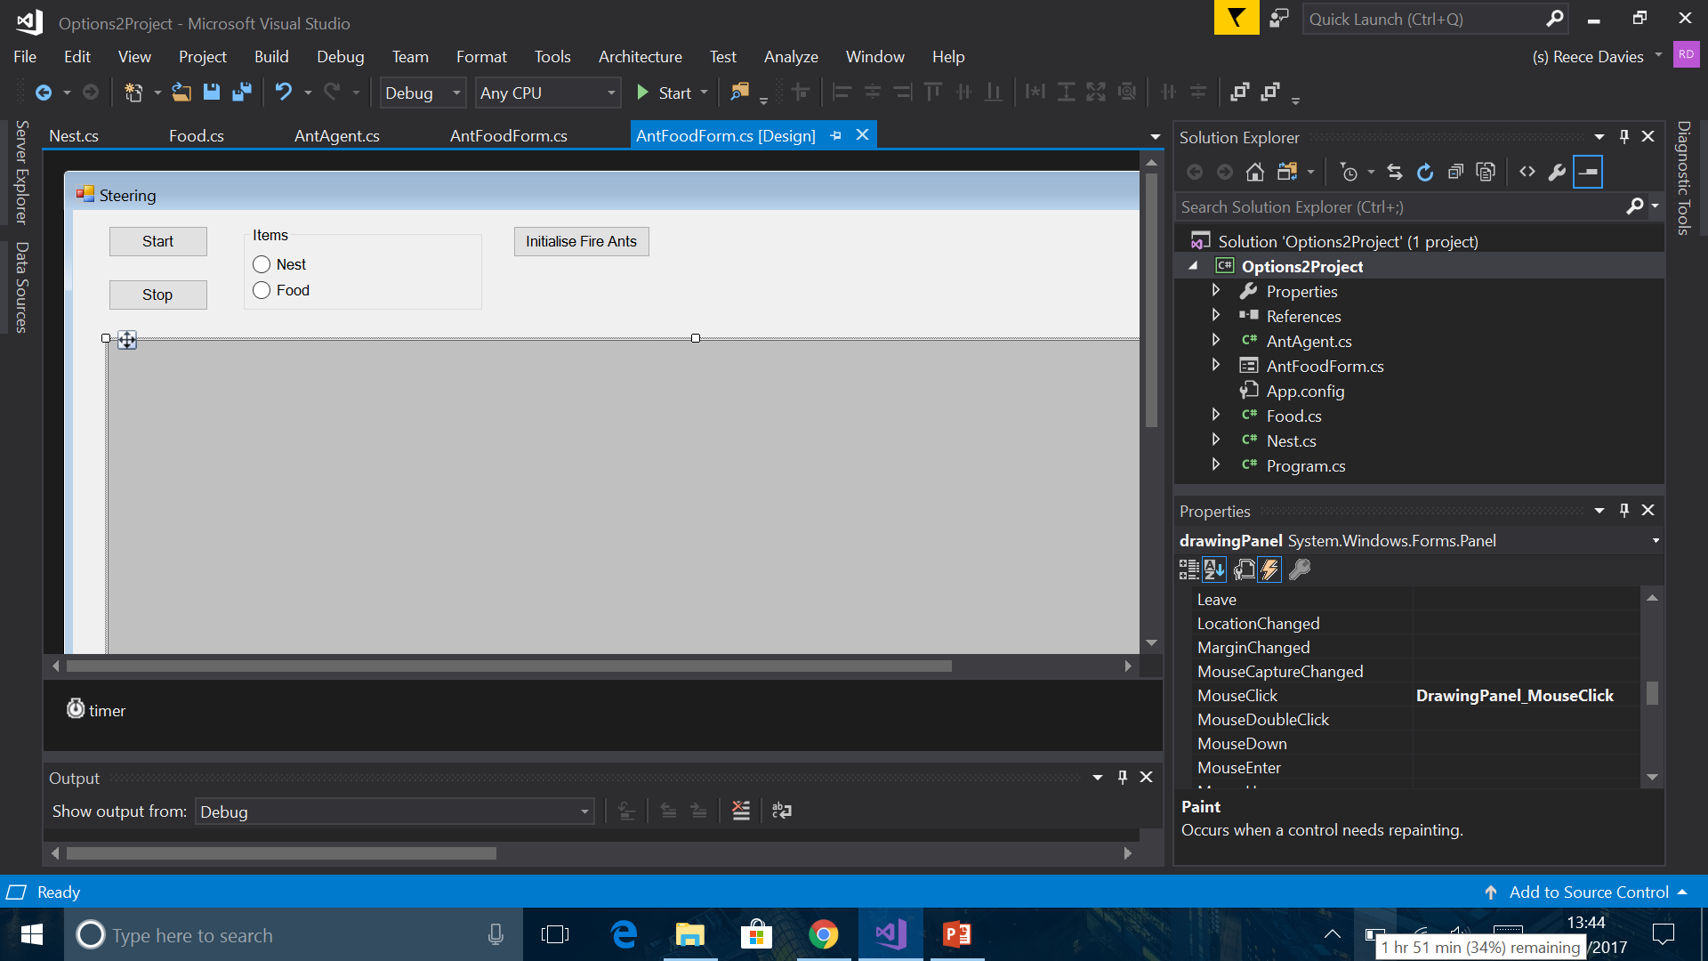
Adding new food/nest items to their list.
Created a new method, for when the user clicks on the form. It uses IF statements to checked which radio button has been checked. Depending on which one is checked, the method will create a new item to the specified list.

Slide 12
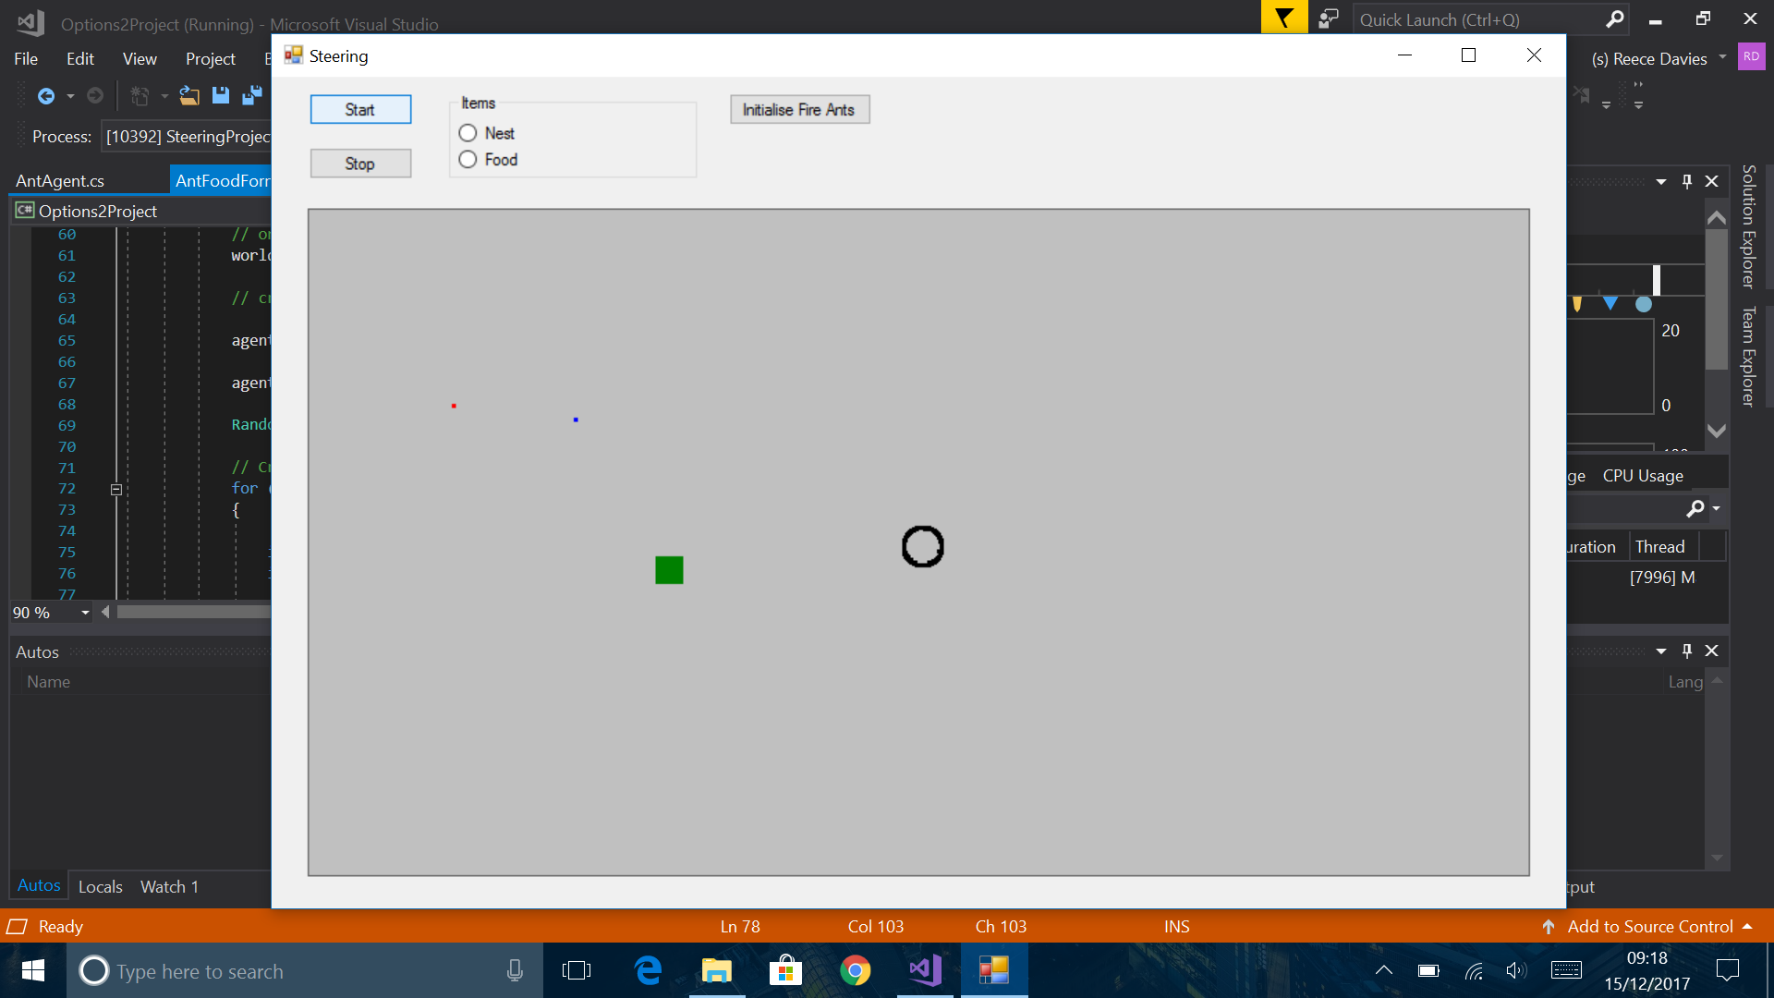

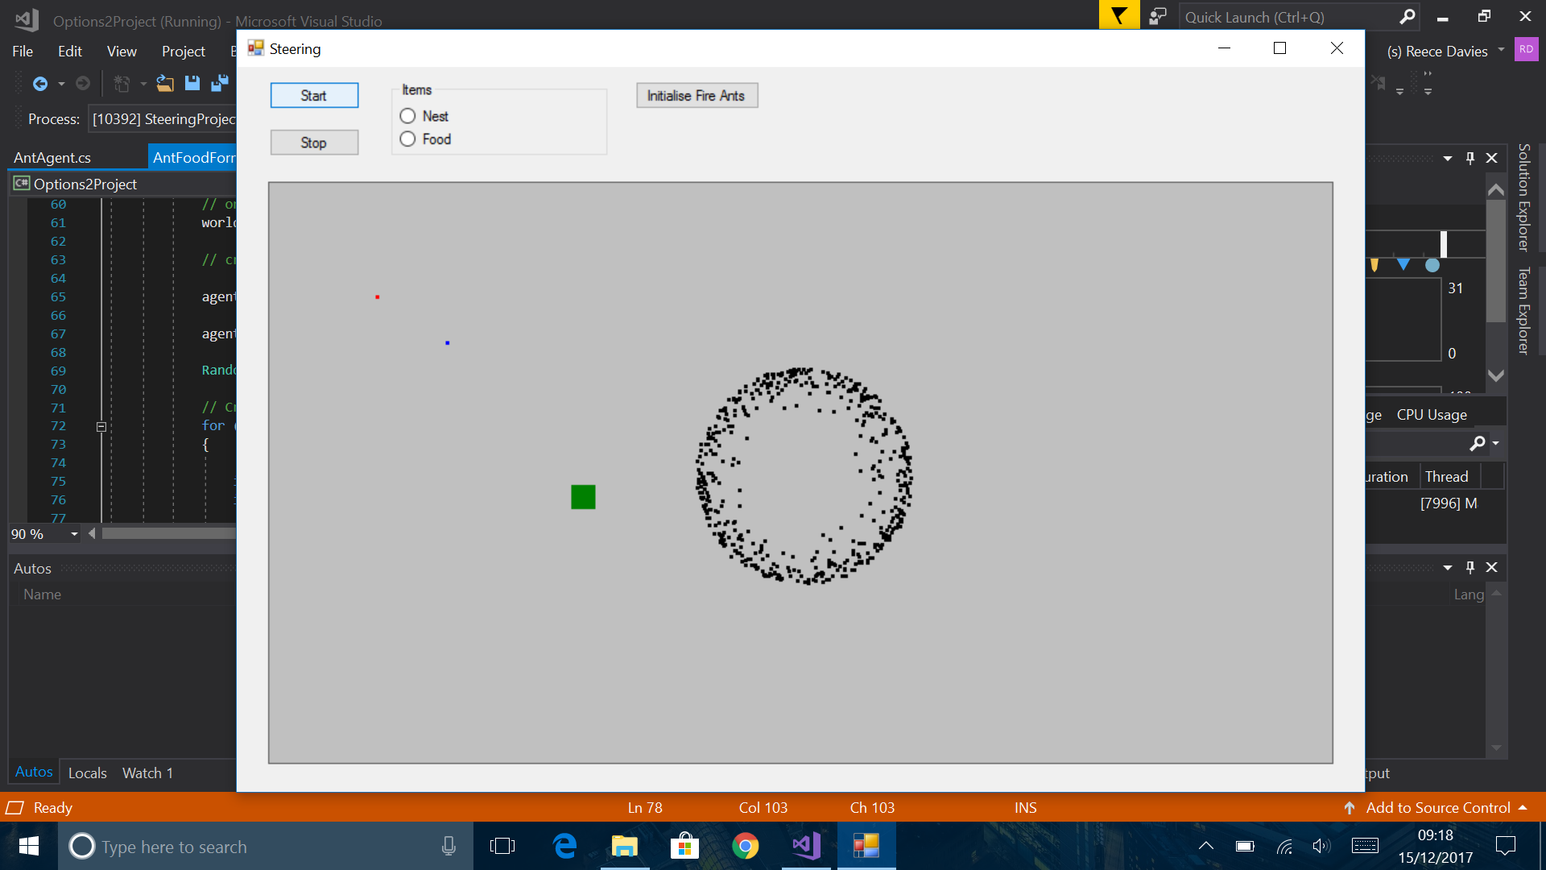
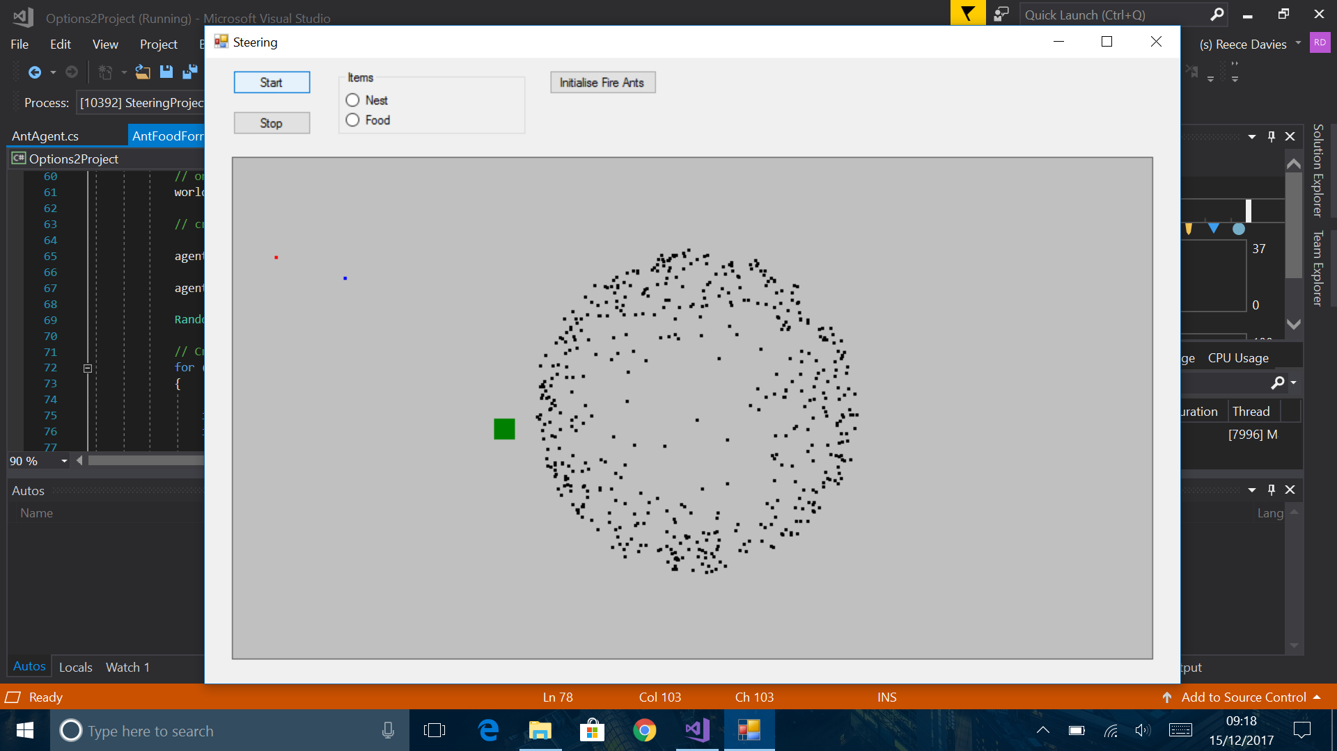
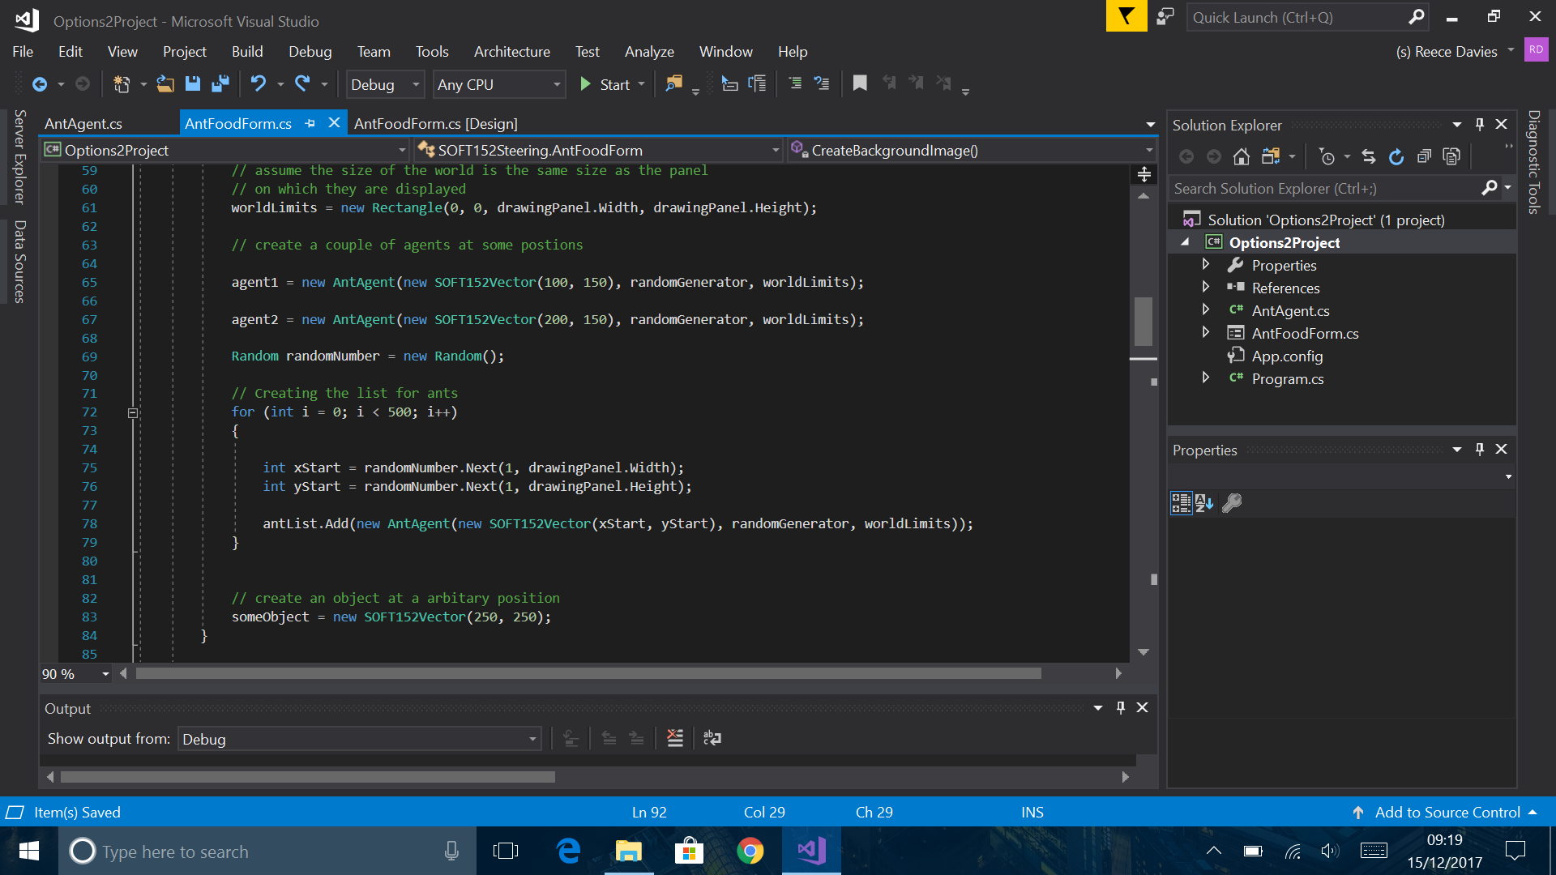
Starting location of the ants
They were originally at a specific coordinate, but this caused an effect of when it started debugging. The ants would spread out, as if they were being released from a small jar. I then changed it by creating a Random.
This could be something that could be implemented when the user wants control over where they release the ants, and how many they release.
I believe I will implement this with the robber ants.

Slide 13

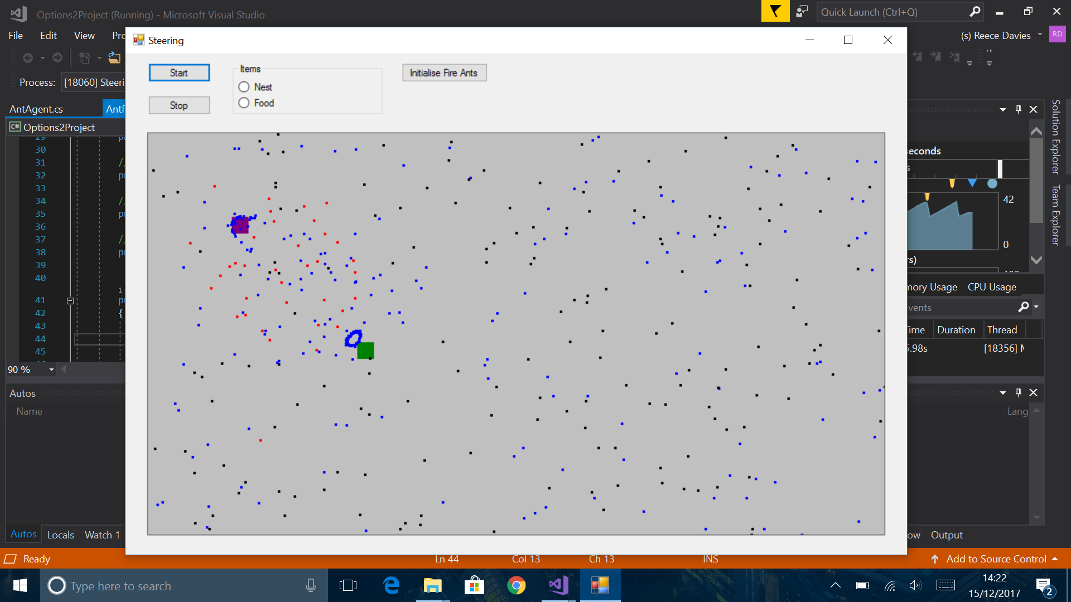
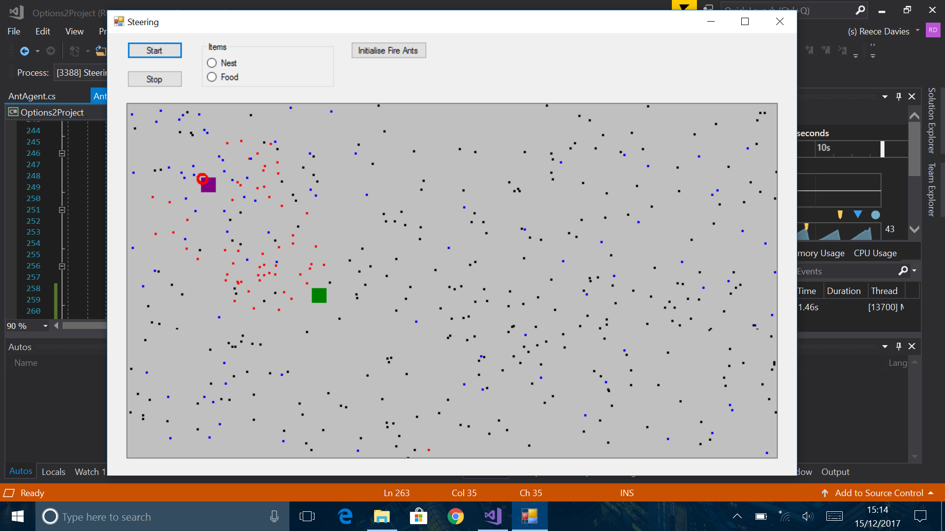
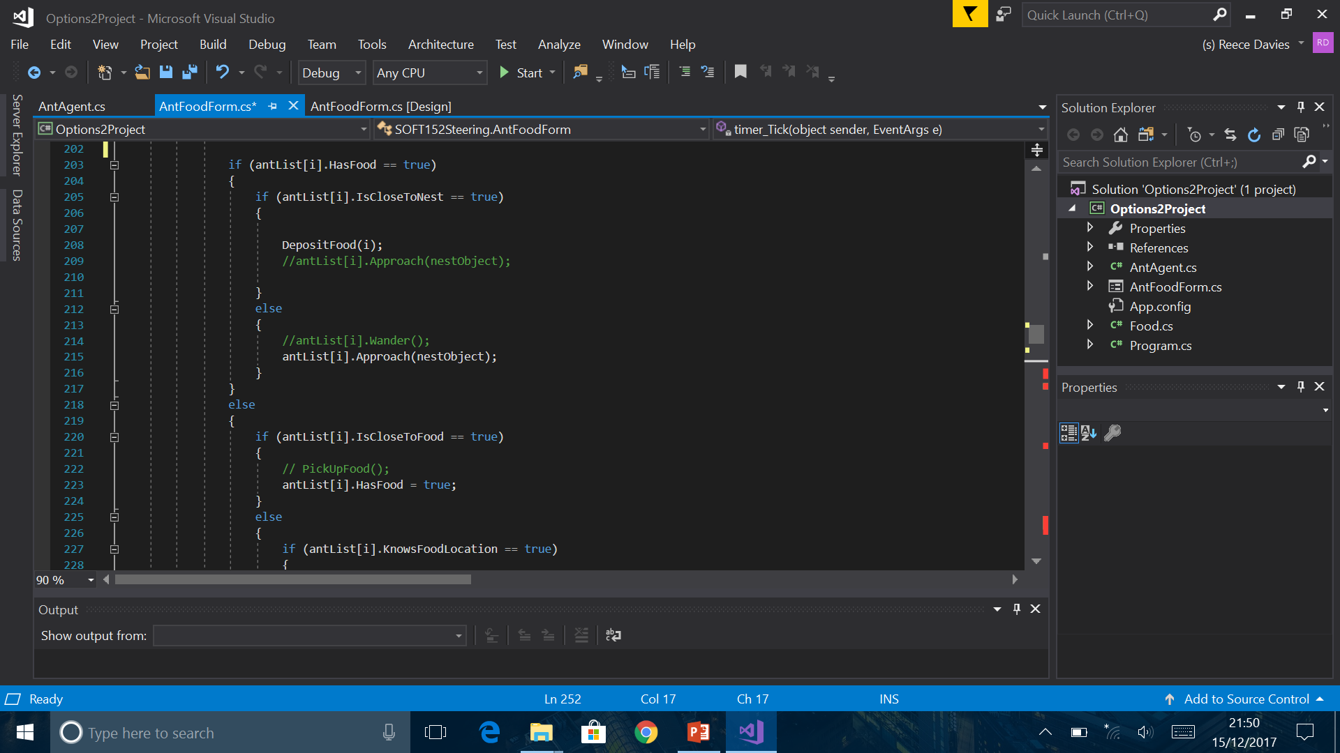
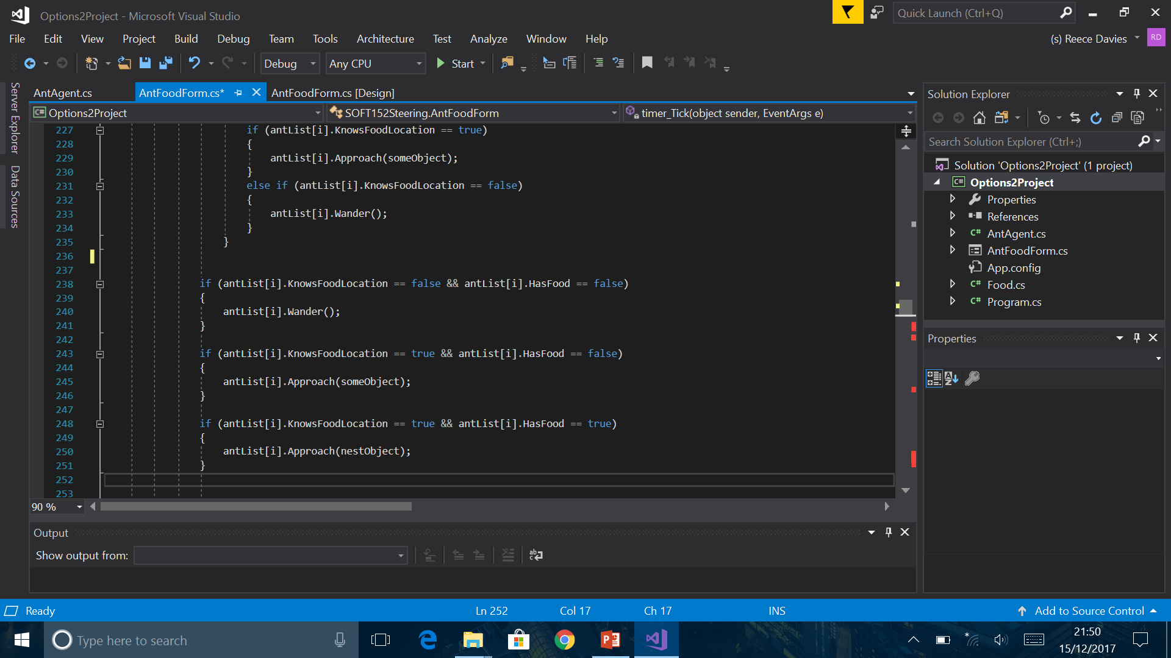
Logic errors
I changed the colour of the ants depending on the situation. They would appear red if they are carrying food, blue if the are not carrying food and know where the nest is, and black if neither of the cases apply. This would allow me to understand relevant errors, and be able to solve the problem quickly.
These were logic errors that occurred when debugging, and the ants would behave normally until a certain point and they would not leave a specific coordinate.
I changed the IF statements; and removed the ‘IsCloseTo’ Booleans. It was far too complicated.

Slide 14
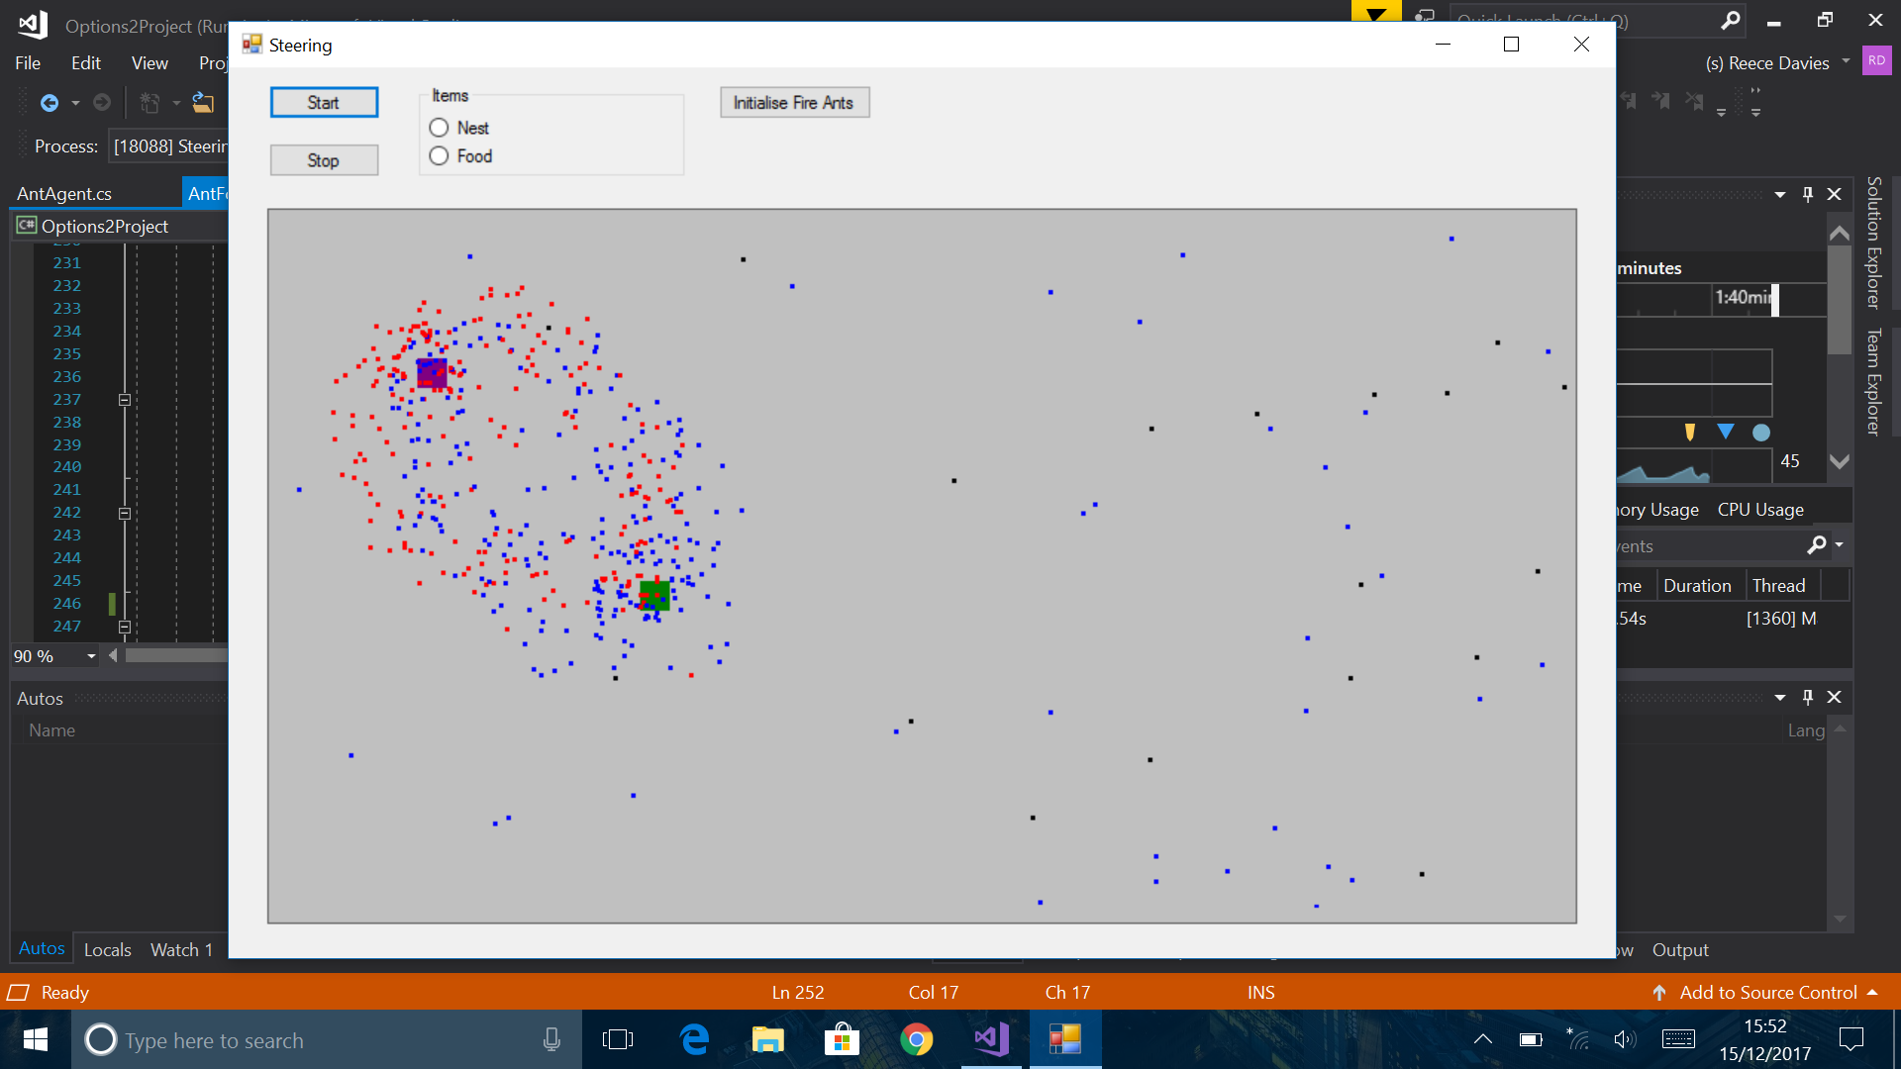
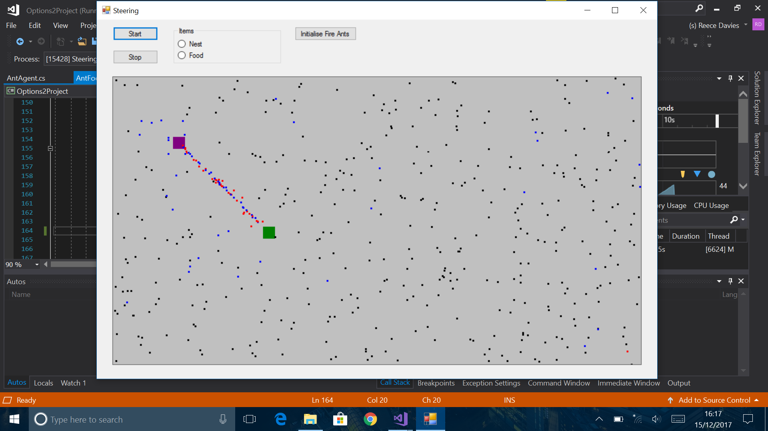
More errors
Once I recreated the if statement structure, the ants started to behave properly. However, they were moving very slowly and with a curve. After testing; I found that the issue was a ‘Wander’ method that had not been removed. I can implement this later to give the ants a more realistic appearance.

Slide 15
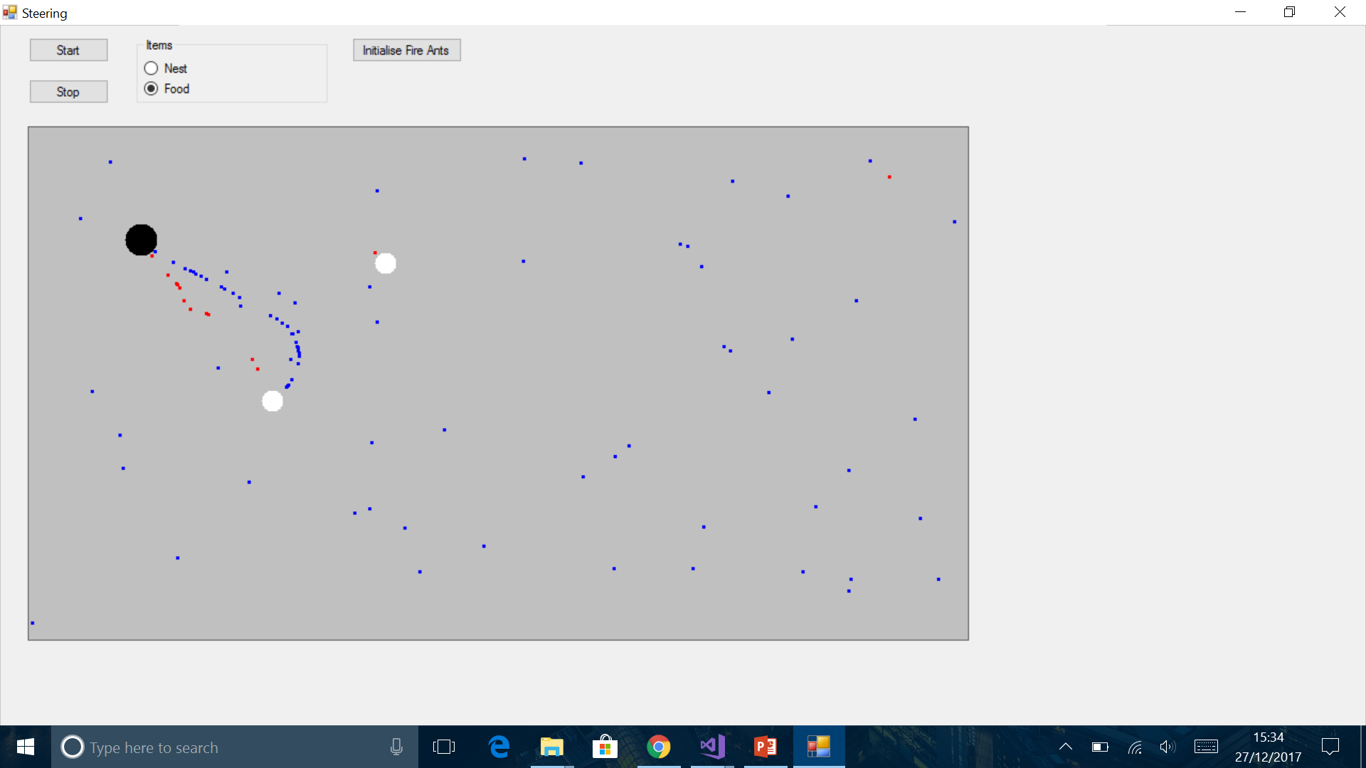
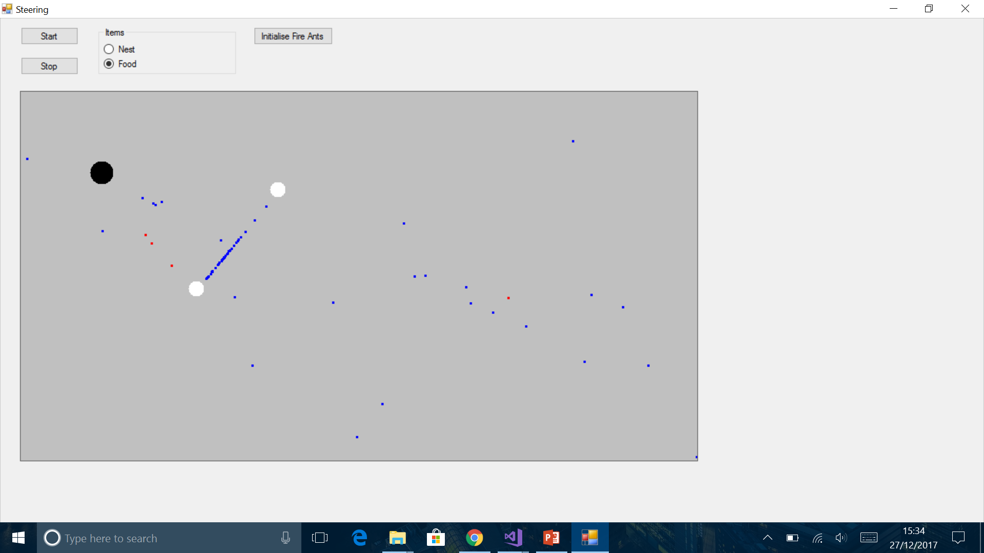
Even more errors
This is an error that occurred shortly after creating the food list. The ants will approach the food, perfectly until the user places more than one blocks of food. The ants will get stuck between the two blocks of food. This is because they are attempting to approach both food vectors. At the moment, the ants will only remember one nest, and 1 food. So if they know a nest location, they will go to that nest with food, even if another nest is closer. They also do this with the food.

Slide 16
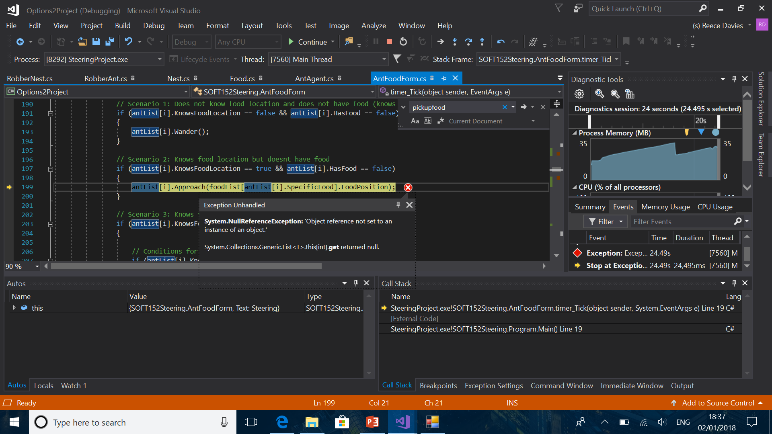
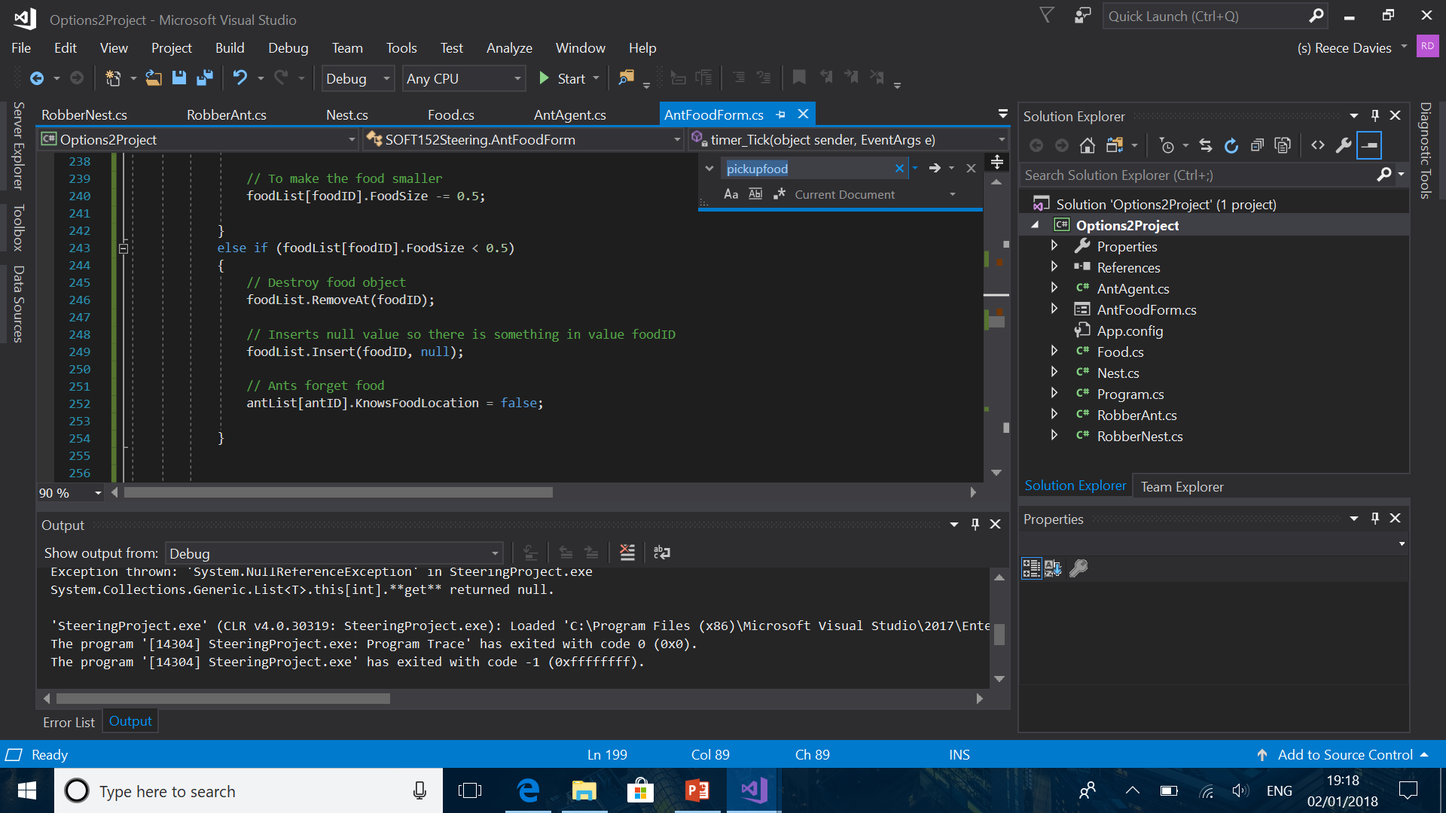
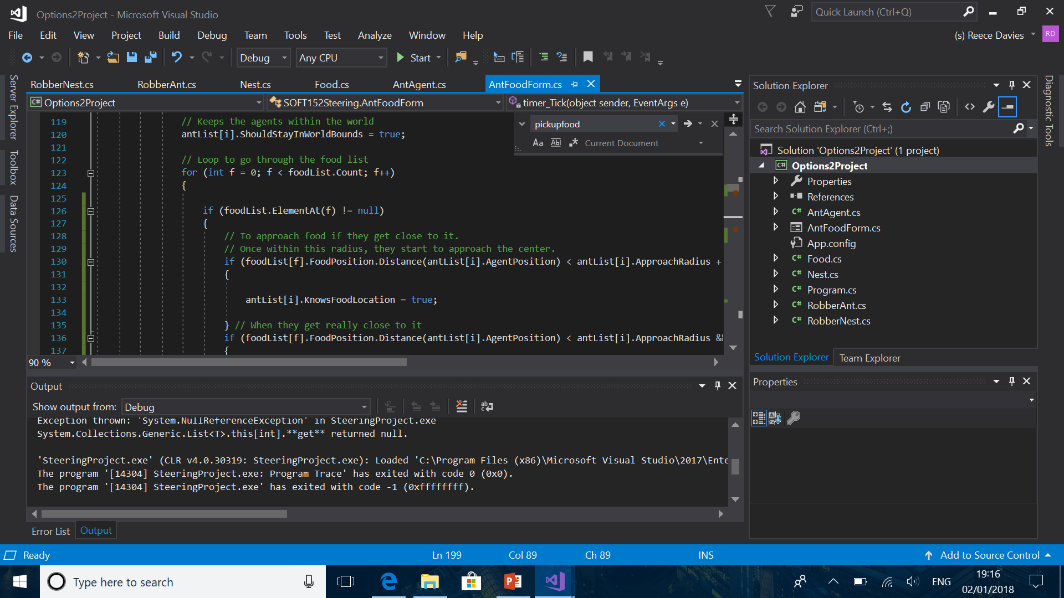
Exceptions problem 1
After removing the food item from the list. Certain errors occur. Specifically exceptions, in which it goes through the loop. An exception is thrown because it goes through an item in the list that contains a null value. To fix this; I put an if statement that checks if the item in the list is a null value. If it is, it will not consider it.

Slide 17
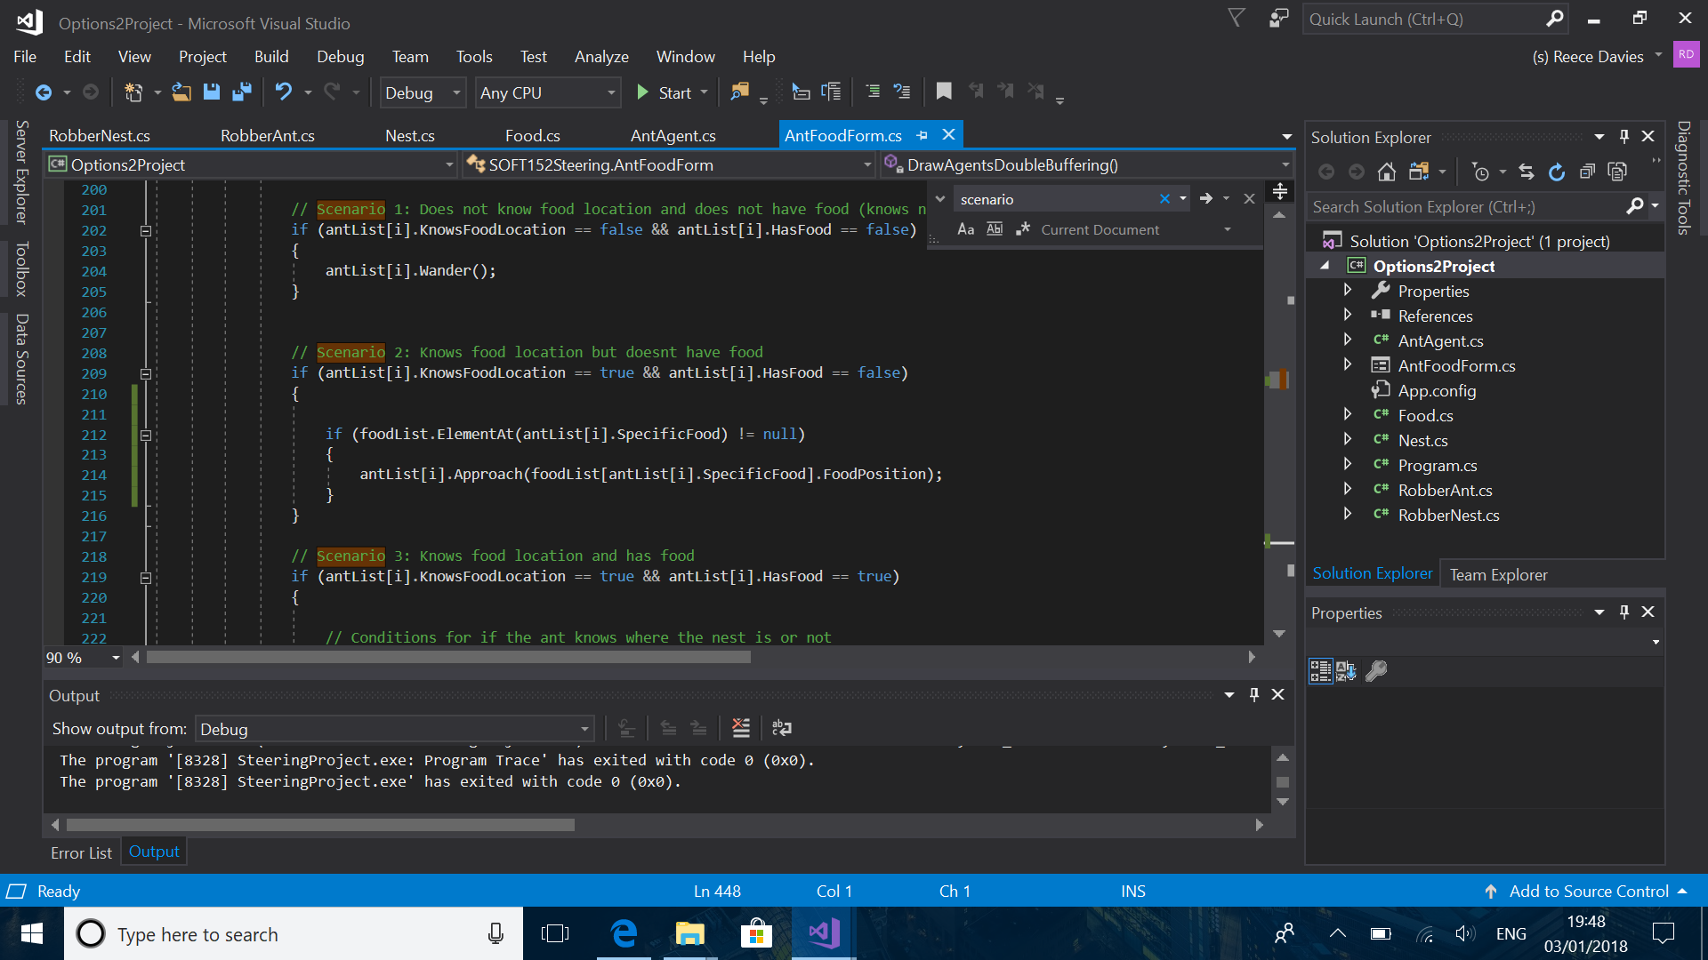

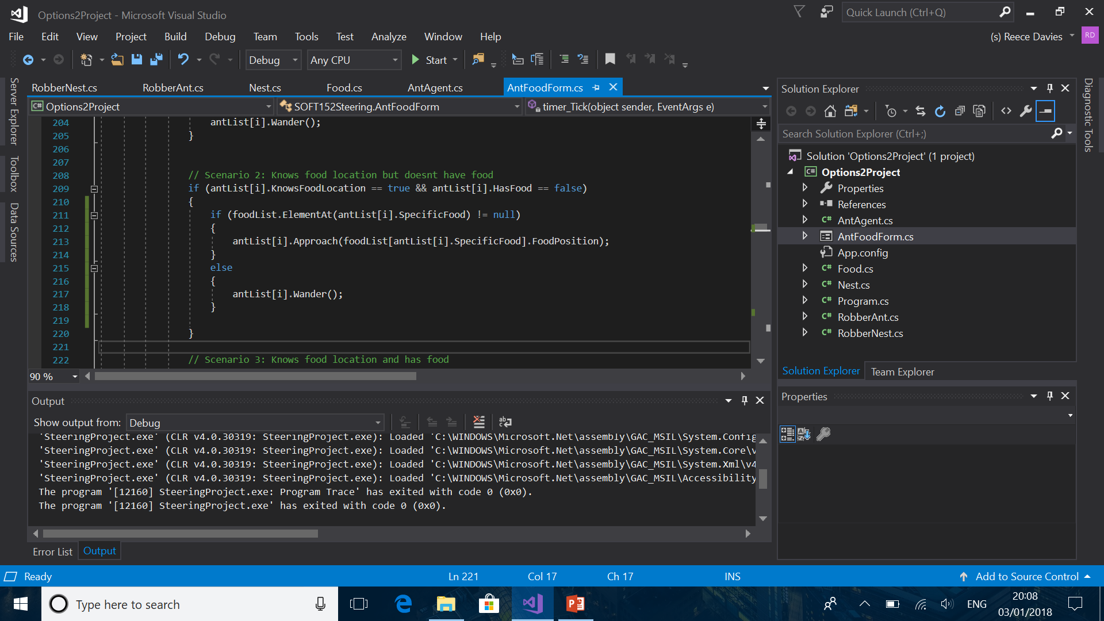
Exceptions problem 1 (The ‘will to live’ glitch)
Just added (!= null) if statements and it fixed the exceptions. However other errors arose. Logic errors, when the ants lost the will to live and were doing nothing. The will to live glitch was occurring because they had nothing to do as there was no scenario in this situation.

Slide 18
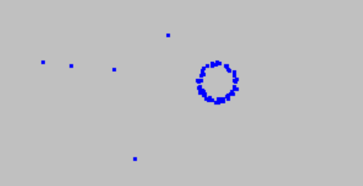
Exceptions problem 2
Tried to change it that it would instead not consider the food object if it is under a certain size, instead of removing it. But this causes a logic error with ‘KnowsFoodLocation’. The ants wouldn’t leave the food when there is nothing there. This is because of the ‘SpecificFood’ variable.

Slide 19
Early testing
antList[i].AgentPosition.X > foodObject.X - antList[i].ApproachRadius && antList[i].AgentPosition.X < foodObject.X + antList[i].ApproachRadius && antList[i].AgentPosition.Y > foodObject.Y - antList[i].ApproachRadius && antList[i].AgentPosition.Y < foodObject.Y + antList[i].ApproachRadius
This was some code that I used to see if the ants were within a specific distance from the food. It was the condition in the IF statement. I changed it to the ‘Distance’ upon realising that this may provoke some future errors when altering the code. It was also annoyingly long.
Had to do this for when the ants asked for directions. But instead did it with a nested if statements. One was for horizontal distance, and the other was for vertical distance.

Slide 20
Framerate
As I was creating the program on my personal laptop, this meant that I had some debugging issues when running the program AND having the ant List with a high number. This is because the program contains multiple loops, including a nested loop.

Slide 21
Old code (scenarios)
// Scenarios for each case
if (antList[i].KnowsFoodLocation == false && antList[i].HasFood == false) // Knows nothing
{
antList[i].Wander();
}
else if (antList[i].KnowsFoodLocation == true && antList[i].HasFood == false) // Knows food location but
{ // doesn't have food
antList[i].Approach(foodObject);
}
else if (antList[i].KnowsFoodLocation == true && antList[i].HasFood == true) // Knows food location
{ // AND has food
// Conditions for if the ant knows where the nest is or not
if (antList[i].KnowsNestLocation == true)
{
antList[i].Approach(nestObject);
}
else
{
antList[i].Wander();
}
}

Slide 22
Old code (close to X)
// To approach food if they get close to it.
// Once within this radius, they start to approach the center.
if (foodObject.Distance(antList[i].AgentPosition) < antList[i].ApproachRadius * 3 && antList[i].HasFood == false)
{
antList[i].KnowsFoodLocation = true;
} // When they get really close to it
if (foodObject.Distance(antList[i].AgentPosition) < antList[i].ApproachRadius && antList[i].HasFood == false)
{
PickupFood(i);
}
// To approach nest if they get close to it
// Once within this radius, they start to approach the center.
if (nestObject.Distance(antList[i].AgentPosition) < antList[i].ApproachRadius * 3)
{
antList[i].KnowsNestLocation = true;
} // When they get really close to it
if (nestObject.Distance(antList[i].AgentPosition) < antList[i].ApproachRadius)
{
PutDownFood(i);
}

Slide 23
Old code (agents behaviour)
SOFT152Vector tempPosition;
// one each time tick each of the two agents makes one movment
// set some values for agent1
// before it moves
agent1.AgentSpeed = 1.0;
agent1.WanderLimits = 0.25;
// keep the agent within the world
agent1.ShouldStayInWorldBounds = true;
// let agent1 wander
agent1.Wander();
// again set some values for agent2 before moving
// agent2 is slower than agent1 to show some following behaviour
agent2.AgentSpeed = 0.9;
agent2.AvoidDistance = 100;
agent2.ShouldStayInWorldBounds = true;
// get agent1 position
tempPosition = agent1.AgentPosition;
// agent2.FleeFrom(tempPosition);
agent2.Approach(tempPosition);
// or get the agent to approach or flee from the stationary object
// agent2.Approach(foodObject);
// after making a movement, now draw the agents
//DrawAgents();

Slide 24
Old code (drawing food and nest)
// Drawing food
solidBrush = new SolidBrush(Color.White);
backgroundGraphics.FillEllipse(solidBrush, (float)foodObject.X - 10, (float)foodObject.Y - 10, 20, 20);
// Drawing nest
solidBrush = new SolidBrush(Color.Black);
backgroundGraphics.FillEllipse(solidBrush, (float)nestObject.X - 10, (float)nestObject.Y - 10, 30, 30);

Slide 25
Old code (pre set DrawAnts)
g.Clear(Color.White);
// get the 1st agent position
agentXPosition = (float)agent1.AgentPosition.X;
agentYPosition = (float)agent1.AgentPosition.Y;
// create a brush
solidBrush = new SolidBrush(Color.Black);
// draw the 1st agent
g.FillRectangle(solidBrush, agentXPosition, agentYPosition, antSize, antSize);
// get the 2nd agent position
agentXPosition = (float)agent2.AgentPosition.X;
agentYPosition = (float)agent2.AgentPosition.Y;
// change colour of brush
solidBrush = new SolidBrush(Color.Blue);
// draw the 2nd agent
g.FillRectangle(solidBrush, agentXPosition, agentYPosition, antSize, antSize);
// now draw the stationary object
// change colour of brush
solidBrush = new SolidBrush(Color.Green);
g.FillRectangle(solidBrush, (float)foodObject.X, (float)foodObject.Y, 20, 20);

Slide 26
Old code (pre set DrawAgentsDoubleBuffering)
// get the 1st agent position
agentXPosition = (float)agent1.AgentPosition.X;
agentYPosition = (float)agent1.AgentPosition.Y;
// create a brush
solidBrush = new SolidBrush(Color.Red);
// draw the 1st agent on the backgroundImage
backgroundGraphics.FillRectangle(solidBrush, agentXPosition, agentYPosition, antSize, antSize);
// get the 2nd agent position
agentXPosition = (float)agent2.AgentPosition.X;
agentYPosition = (float)agent2.AgentPosition.Y;
// change colour of brush
solidBrush = new SolidBrush(Color.Blue);
// draw the 2nd agent on the backgroundImage
backgroundGraphics.FillRectangle(solidBrush, agentXPosition, agentYPosition, antSize, antSize);

